Slide 1
Advantages of education
M.Junaid

Slide 2
1. Creating More Employment Opportunities
“Finding a job” is probably one of the most common reasons people choose to pursue a college degree, as we are all well aware of the difficulties of landing a good job. In most cases, tens of candidates are applying for the same position, and a college degree can help set you apart from others. In addition, a college education will create more employment opportunities as you will be qualified for more than low-paying and entry-level jobs.

Slide 3
4. Developing Critical-Thinking Skills
Higher education equips you with the knowledge and essential skills necessary to join the workforce. One of the most vital skills you will develop when pursuing a college degree is the ability to think critically. Critical thinking skills are an advantage and sometimes even a requirement to succeed in your career. By developing critical-thinking skills, you can improve your work’s quality, solve problems, and prevent possibissues that might arisele.

Slide 4
2. Leading to Career Advancement
If you have already joined the workforce and love your job, you might think you don’t need to pursue a college or university education. We are here to tell you that a college degree can have other benefits than just landing you a job. By receiving higher education, you gain the knowledge and skills that will give you a competitive edge and allow you to advance your career in a chosen field.

Slide 5
3. Securing a Better Income
As previously mentioned, a college education can be grounds for career advancement. Advancement in your field comes in the form of a new job title and greater responsibilities—consequently, a higher salary and added benefits. You will also qualify for higher-paying entry-level jobs by getting a higher education degree. As a result, a higher wage can grant you financial stability and improve your quality of life.

Slide 6
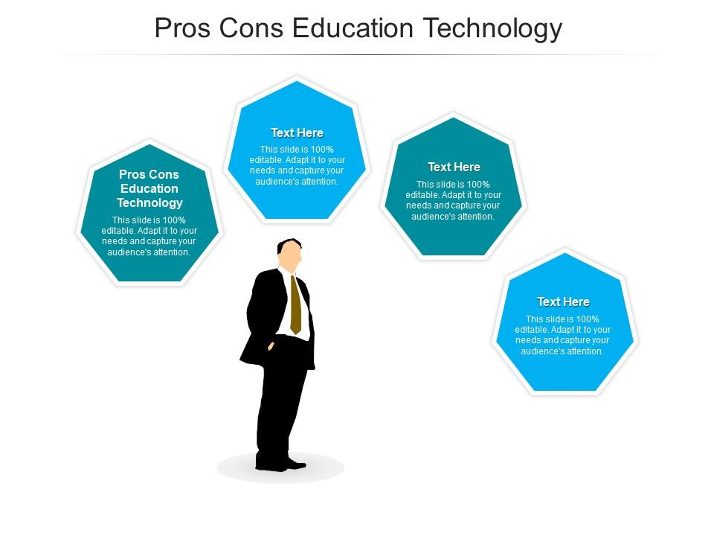

Slide 7


Slide 8


Slide 9


Slide 10
